Slide 1
ENCAPSULATION IN C#

Slide 2
ENCAPSULATION
Encapsulation is one of the four fundamental OOP concepts. The other three are inheritance, polymorphism, and abstraction.
Encapsulation in C# is a mechanism of wrapping the data (variables) and code acting on the data (methods or properties) together as a single unit.
In encapsulation, the variables of a class will be hidden from other classes, and can be accessed only through the methods or properties of their current class. Therefore, it is also known as data hiding.

Slide 3
ENCAPSULATION
In a different way, encapsulation is a protective shield that prevents the data from being accessed by the code outside this shield.
Encapsulation is the procedure of encapsulating data and functions into a single unit (called class)

Slide 4
ENCAPSULATION
To achieve encapsulation in C# −
Declare the variables of a class as private.
Provide public setter and getter methods or properties to modify and view the variables values.

Slide 5
Benefits of Encapsulation
The fields of a class can be made read-only or write-only.
A class can have total control over what is stored in its fields.

Slide 6

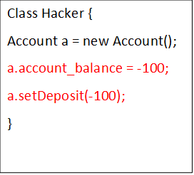

Slide 7
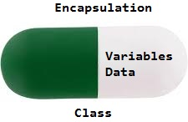

Slide 8
Why do we need encapsulation
The need of encapsulation is to protect or prevent the code (data) from accidental corruption due to the silly little errors that we are all prone to make.

